Slide 1
OSI MODEL
Open Systems Interconnection Basic Reference Model

Slide 2
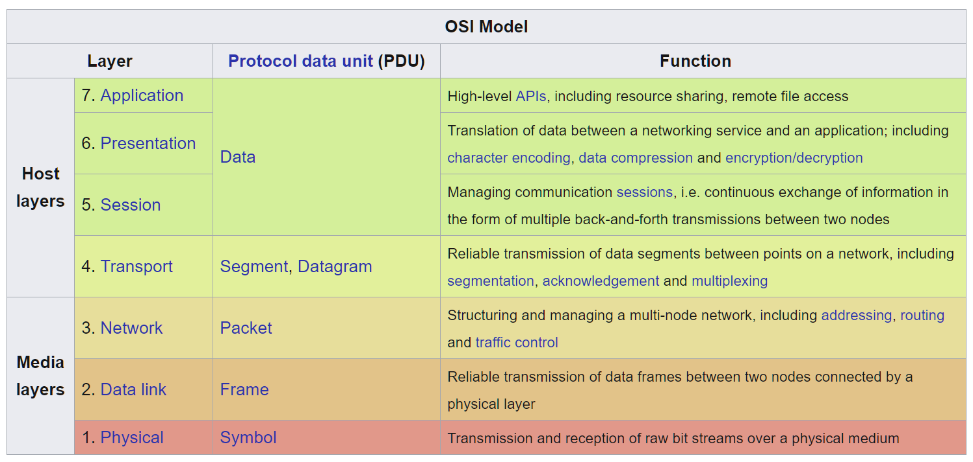

The Open Systems Interconnection model (OSI Model) is a conceptual model that characterizes and standardizes the communication functions of a telecommunication or computing system without regard to its underlying internal structure and technology. The model represents a communication system in the form of abstraction layers (smaller, simpler parts):

Slide 3
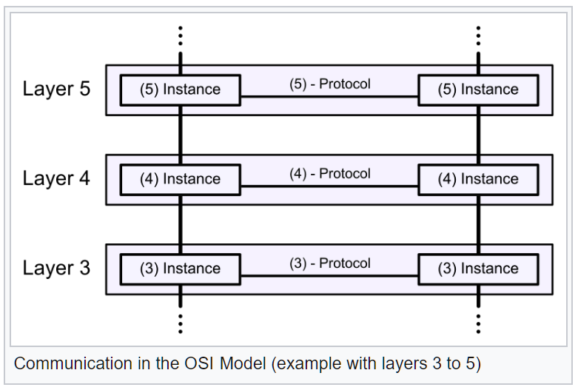
A layer serves the layer above it and is served by the layer below it. For example, a layer that provides error-free communications across a network provides the path needed by applications above it, while it calls the next lower layer to send and receive packets that comprise the contents of that path. Two instances at the same layer are visualized as connected by a horizontal connection in that layer.
Example of communication in the OSI Model:

Slide 4
OSI Model was first introduced in the 1984 by the International Organization for Standardization (ISO).
The OSI Model
outlines WHAT needs to be done to send data from one source (computer) to another, not HOW it should be done.
protocols stacks handle how data is prepared for transmittal.
The OSI Model
is a theoretical blueprint that helps understand how data gets from one user’s computer to another.
is a model that helps develop standards of communication of all our hardware and software
aids standardization of networking technologies by providing an organized structure for hardware and software developers to follow, to insure the products are compatible with current and future technologies.

Slide 5
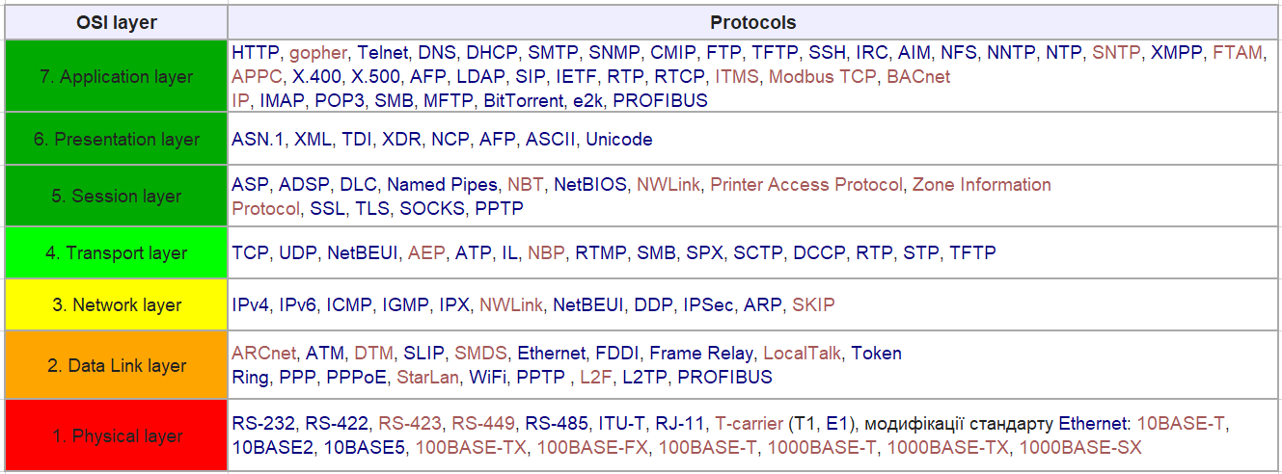
OSI layers

